Slide 1
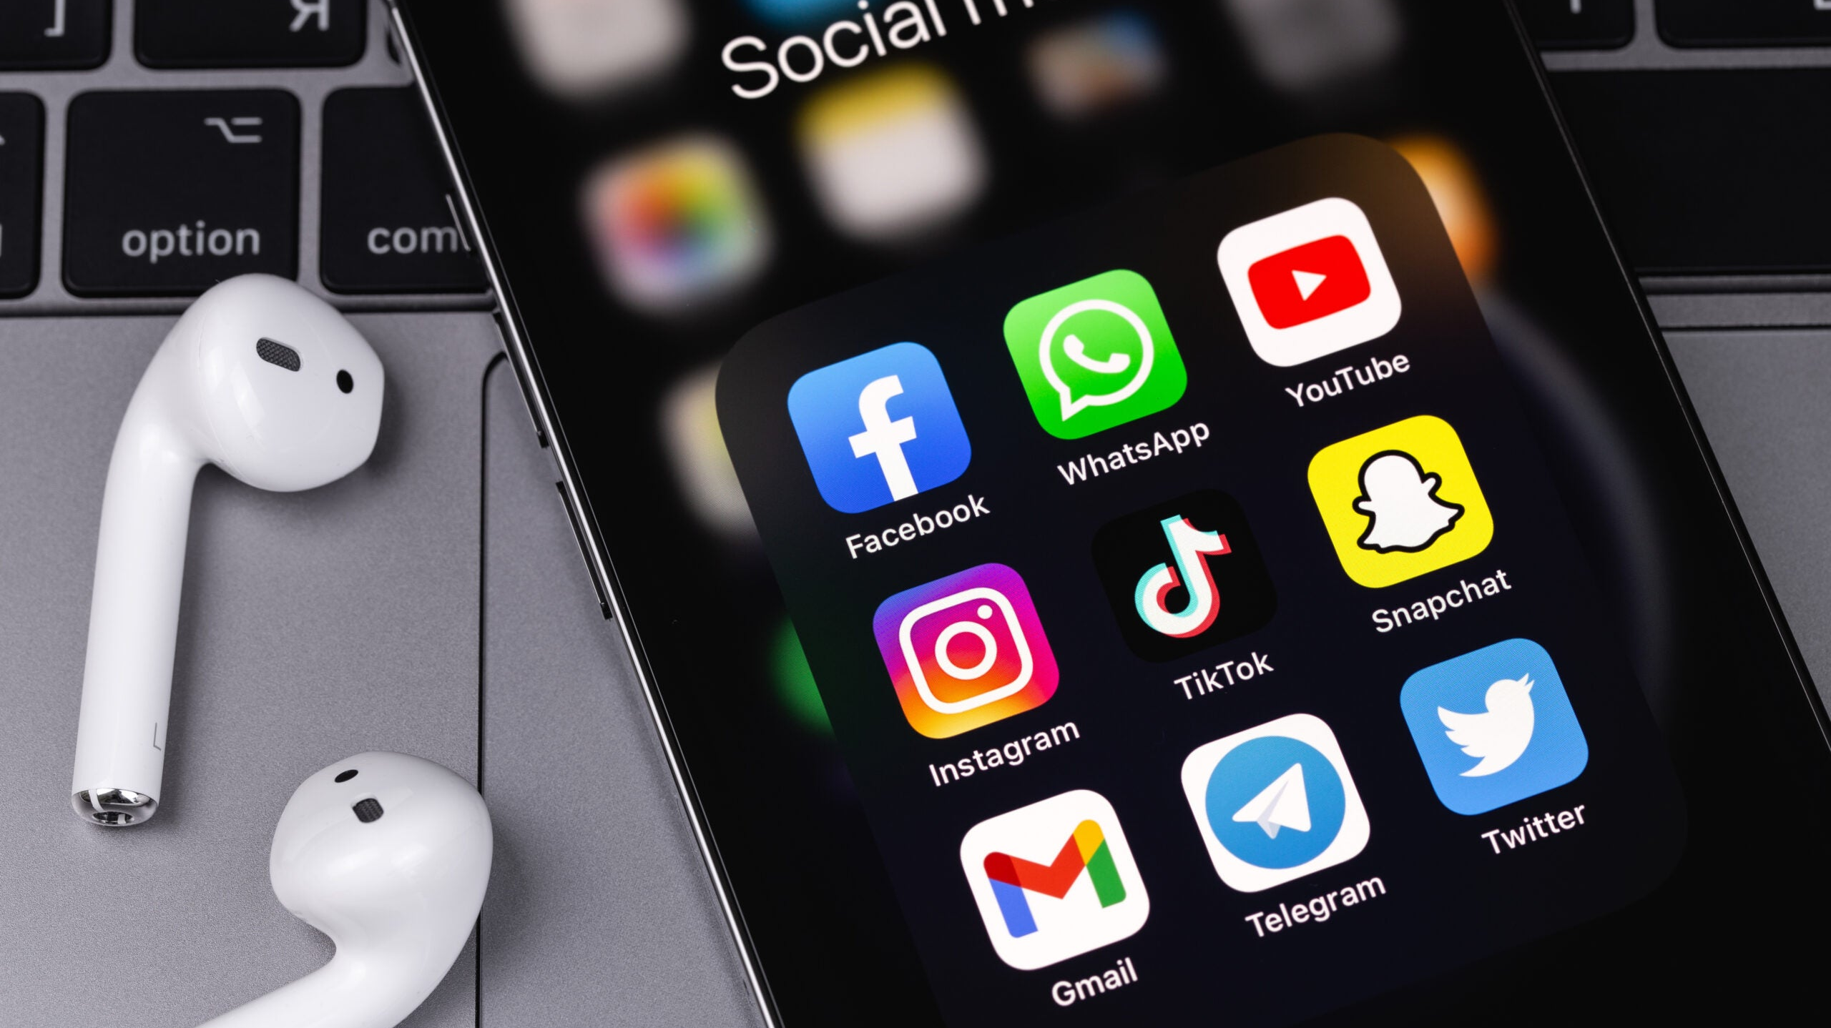
Staying Safe On Social Media

Slide 2
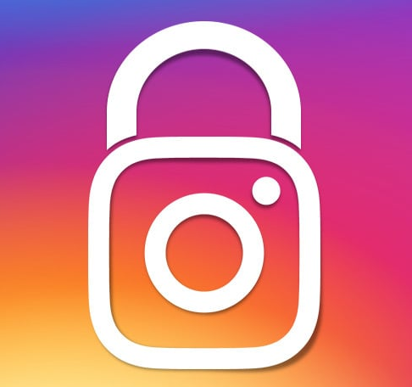
Instagram
There are many ways to stay safe on Instagram, some of these methods include:
Enabling two-factor authentication
Make your account private
Only accept follow requests from people that you know
Disabling your activity status
Block, Restrict, or Report any accounts that are harassing you
Don't give out personal information.
Here is some more support on how to stay safe on Instagram

Slide 3

Snapchat
There are many ways to stay safe on Snapchat, some of these methods include:
Don't add people that you don't know
Block strangers who try to contact you more than once
Block and report people who send inappropriate or unwanted snaps
Keep your location private
Don't give out personal information
Make your settings friends only such as, who can message you and view your stories.
Here is some more support on how to stay safe on Snapchat

Slide 4

TikTok
Never share sensitive personal information
Use TikTok’s privacy settings to limit who can view, comment, and share your content
Set your account to private
Enable two-step verification
Don’t reuse passwords
Limit comments
Do not click on any links
remove anyone from your list of followers that you do not know
Here is some more support on how to stay safe on TikTok

Slide 5

X
Use a strong password that you don’t reuse on other social media
Use two-factor authentication
Require email and phone number to request a reset password link or code
Deactivate Tweet Location so people cannot find your location
Edit Discoverability so that people cannot add you because they have your email or phone number
Make your account private
Here is some more support on how to stay safe on X

Slide 6

Facebook
There are many ways to stay safe on Facebook, some of these methods include:
Set the Privacy settings on your profile to friends
Never share your phone number, email address or your home address
Never post information regarding an upcoming vacation or trip as your status
Change your password every so often
Do not friend someone that you do not know
Here is some more support on how to stay safe on Facebook

