Slide 1
Prevent

Slide 2
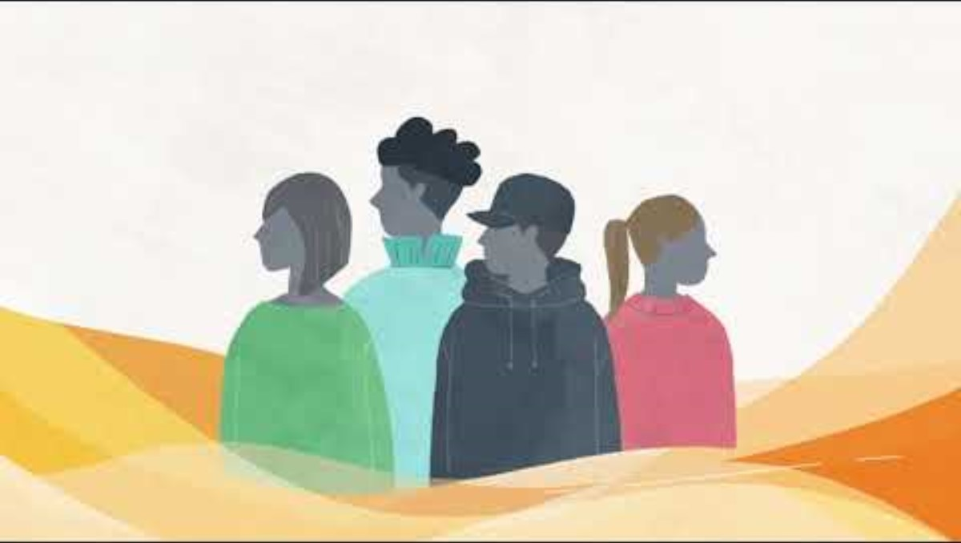
What is prevent?
Prevent is a safety net against radicalisation. It aims to intervene early, to stop people from becoming terrorists or supporting terrorism.
For people who are susceptible to radicalisation, prevent can provide personalised interventions to help them move away from dangerous ideologies.
Below is a short film that illustrates how public sectors under the Prevent duty work together to stop radicalisation.

Slide 3

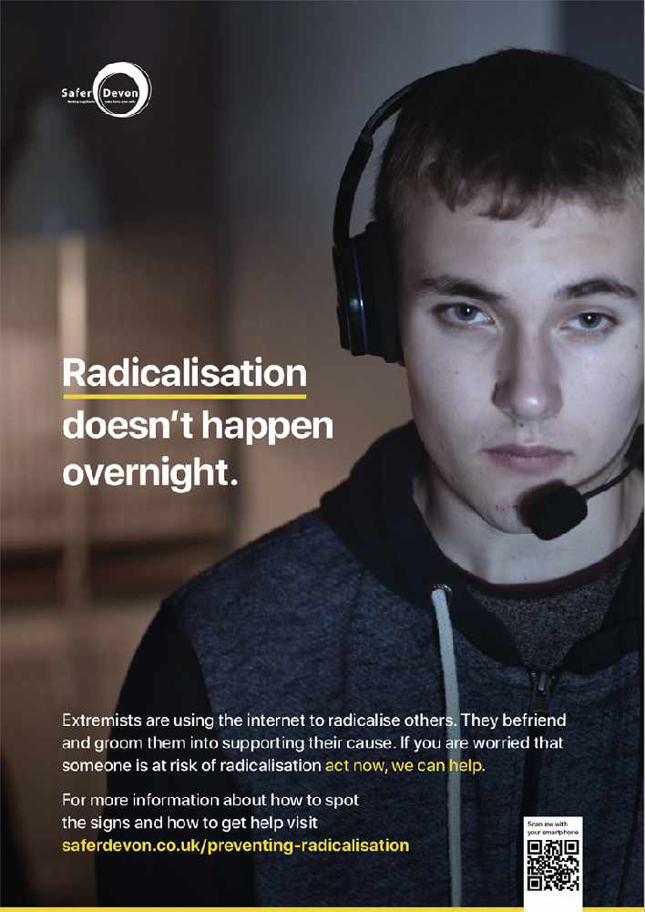

What is radicalisation?
Radicalisation is when a person develops extreme views or beliefs that support terrorist groups or activities.
There are many ways that a person could become radicalised, and people can become exposed to radicalising influences in-person, or online.
A person’s susceptibility to radicalisation may be linked to their vulnerability. A person can be vulnerable if they need special care, support or protection because of age, disability, risk of abuse, or neglect.
There is no single route to radicalisation, however, there are certain behaviours you can watch out for that we often see when someone is being led down the path of extremism, here are some examples;
Being influence or controlled by a group
Need for identify, meaning and belonging
An obsessive or angry desire for change or ‘something to be done’
Spending an increasing amount of time online and sharing extreme view on social media
Personal crisis
Looking to blame others
Desire for status of a need to dominate.

Slide 4
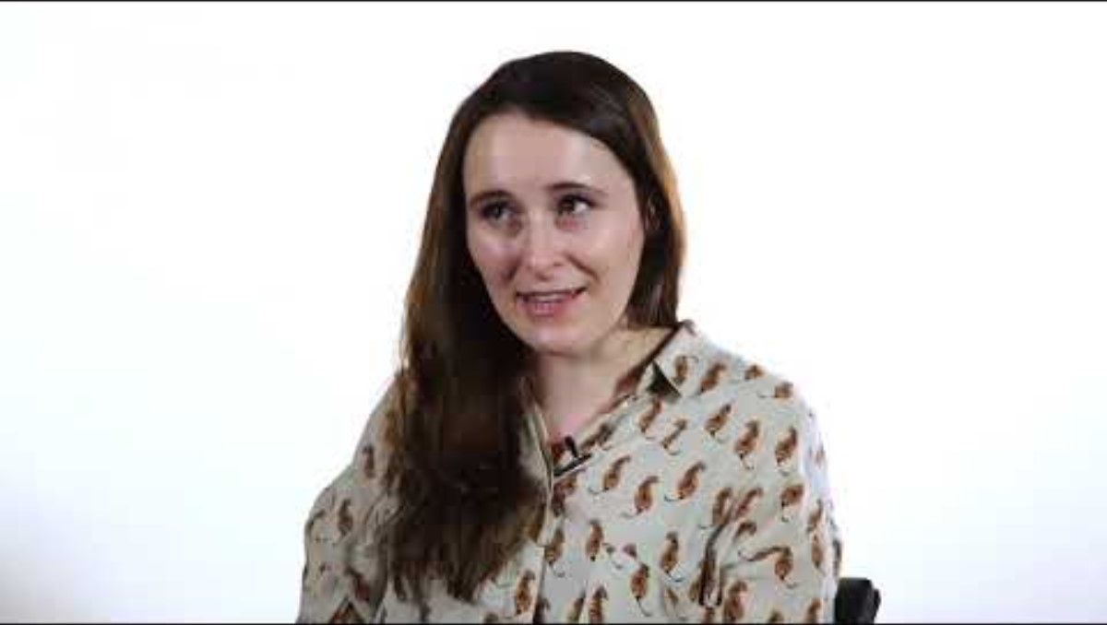
How to prevent radicalisation
If you are concerned that someone was at risk of radicalisation speak to any member of staff who will alert the safeguarding team.
A person of any age can be at risk of radicalisation.

Slide 5


Online Misogyny

Slide 6
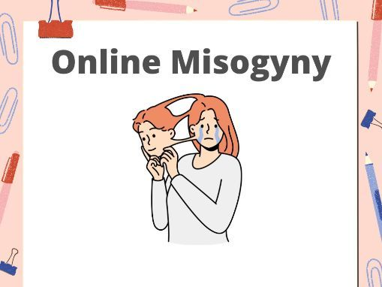
What is Online Misogyny?
Online misogyny is the targeted abuse and harassment of women and girls through the means of the internet. Online misogyny and harassment take many forms, including:
Threats of physical or sexual violence
Posting of intimate images without consent
Generally abusive language or sexist comments
These events take place online as anonymity provides a safe space for cyber bullies and online trolls. Most of the online harassment of women occurs on social media platforms, including Facebook, X, and Instagram. Women also experience harassment on various web forums, chatrooms, and comment sections on news articles and personal blogs.

Slide 7
How does it affect women?
Women report higher levels of emotional stress from online harassment. Psychological impacts include:
Lower self-esteem
Feeling of powerlessness
Trouble sleeping
Feeling of isolation
Increased anxiety or stress
Decreased ability to focus on everyday tasks

Slide 8
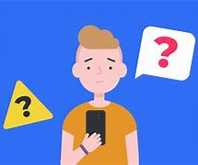
How does it affect Men?
There is a collection of extreme men’s communities that are anti-women on social media, these communities are led by male influencers.
These communities are recommended on multiple platform's but in particular YouTube and TikTok.
These platforms were recommending short videos usually under 30 seconds to a minute and these videos fed misogynistic content more aggressively due to the limited time of the videos.
These videos present masculinist, extremist and anti-feminist content, and the frequency increases once there has been an interaction with this type of content.

Slide 9

Dangers of social media

Slide 10
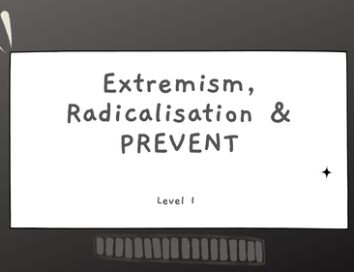
Extremism
In broad terms, extremism is the vocal or active opposition to conventional values. This is often fuelled by a narrow belief which can steer an individual into terrorism. It is the promotion or advancement of an ideology based on violence, hatred or intolerance, that aims to negate or destroy the fundamental rights and freedoms of others;
Terrorism is an example of extremist conduct intended to advance a political, religious, or ideological cause. The process by which someone comes to adopt extremist views is known as radicalisation which has previously been mentioned.

Slide 11
Online bias

Slide 12
What is online bias?
Online Bias is when someone or a group tries to shape opinions by overstating facts or not sharing all the information, it’s called bias. Online, there’s a lot of content, and it’s hard for young people to tell the difference between true information and biased stories. People often have a hidden agenda when promoting information online. They may be aiming to influence public perception, promote a specific ideology, or getting attention for financial or personal gain.

Slide 13
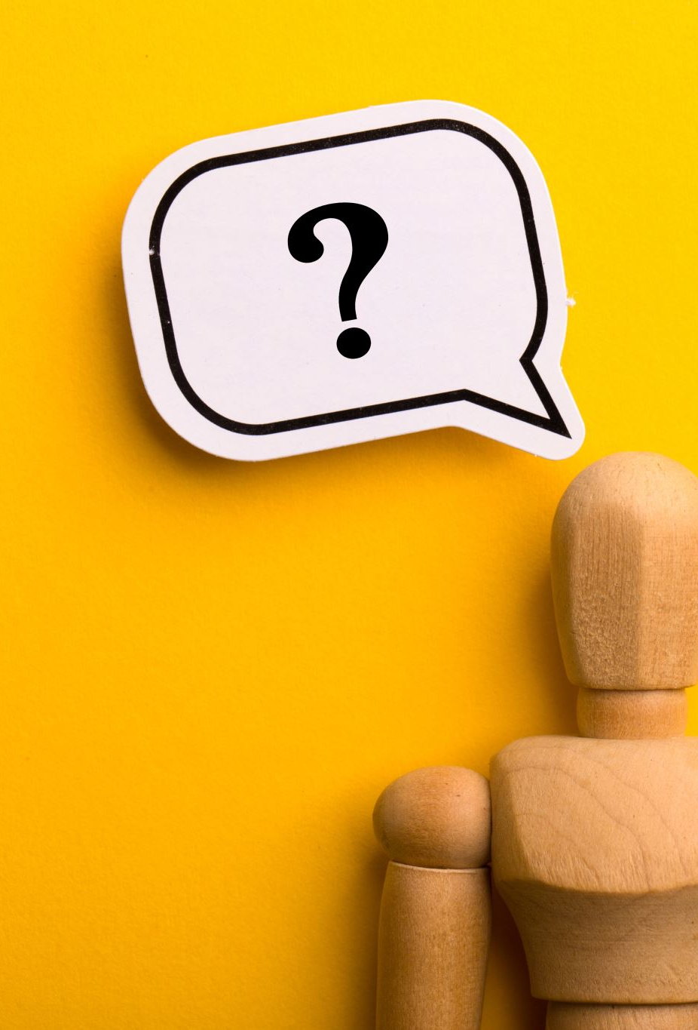
What to look for
Heavily opinionated or one-sided
Relies on unsupported or unsubstantiated claims
Presents highly selected facts that lean to a certain outcome
Pretends to present facts, but offers only opinion
Uses extreme or inappropriate language
Tries to persuade you to think a certain way with no regard for factual evidence
The author is unidentifiable, lacks expertise, or writes on unrelated topics
Is entertainment-based or a form of parody or satire
Tries to sell you something in disguise

Slide 14
Resources
If you want to find out more information know please refer to the link.
signs-of-hate-2020-12-v4.pdf

