Slide 1
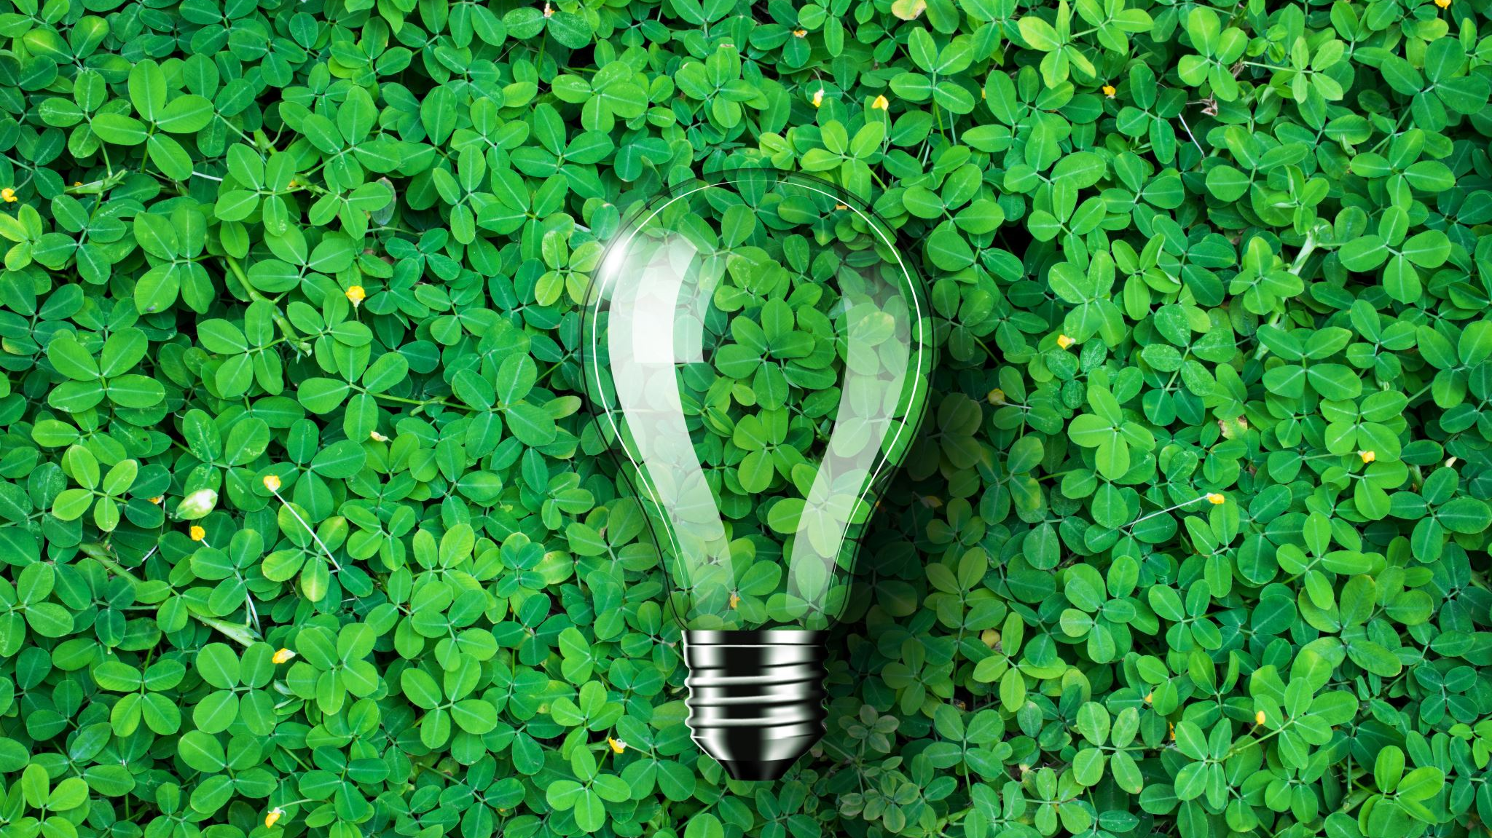
Green Week

Slide 2

What is Green Week?
Green Week is the UK’s biggest ever celebration of community action to tackle climate change and protect nature.
Every year, people come together to unleash a wave of support for action to protect the planet. Tens of thousands of people in every corner of the country celebrate the heartfelt, brave, everyday actions being taken to stand up for nature and fight climate change.
By acting together at the same time, we can create and create conversation around climate change and protecting nature.
We need to get back on track to a world that works for everyone.

Slide 3
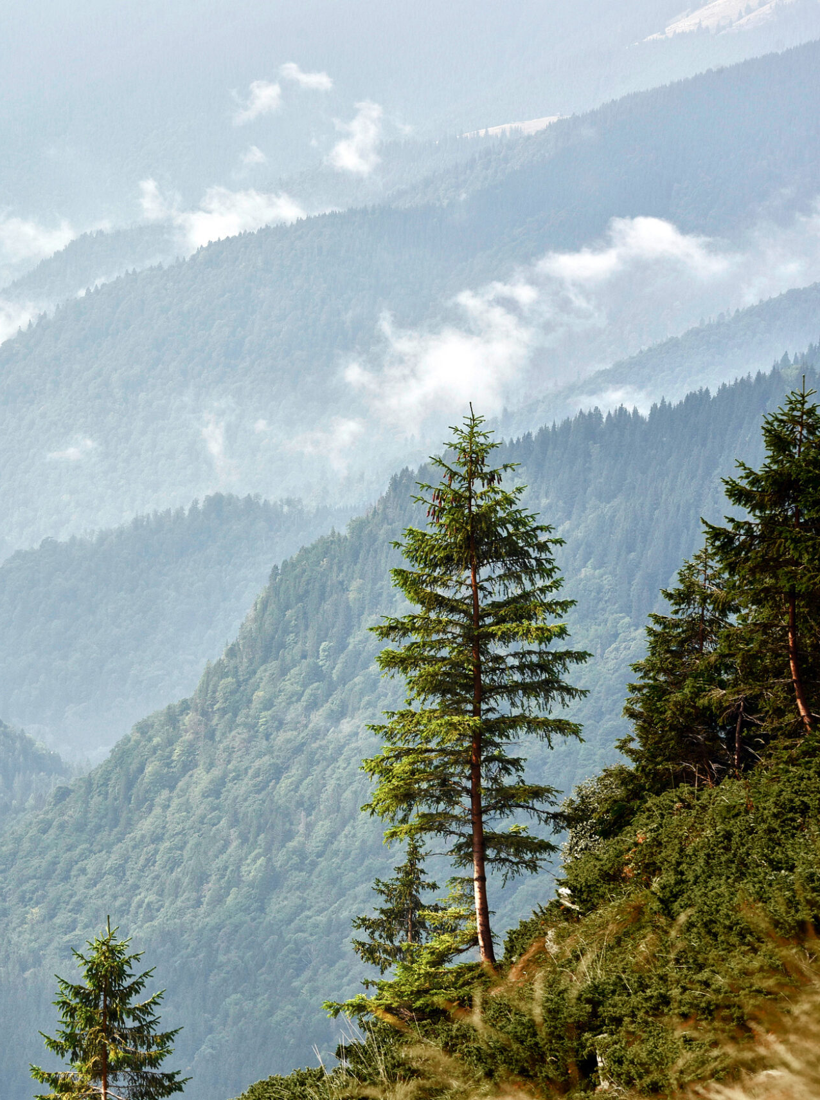
Sustainability
Sustainability is a way of using resources that could continue forever, like renewable energy. A sustain-able activity can be sustained without running out of resources or causing harm.
If something is unsustainable, it means it’s using up resources faster than they’re being replaced. Eventually the resources will run out and the activity won’t be able to carry on.
Sustainability is one of the most important concepts when it comes to fighting climate change and protecting the environment.
Most environmental problems are caused by deforestation and plastic pollution.

Slide 4
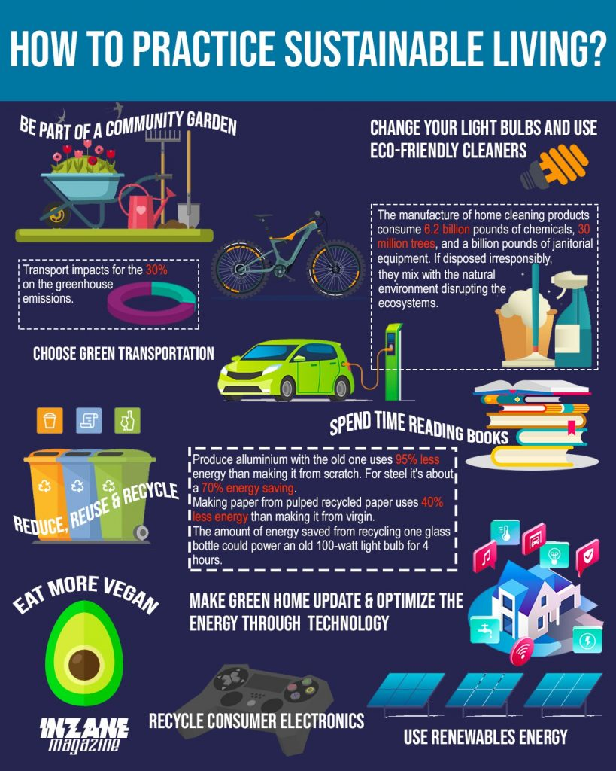
Change your habits to be more sustainable
There are many ways in which we can make slight changes to our habits that can make a big difference and allow you to be more sustainable, these include;
Stop using plastic and start using reuse materials
Choose organic food
Stop buying animal-based textiles
Eat more plants
Save energy
Recycle
The image also mentions other ways in which we can practice sustainable living.

Slide 5
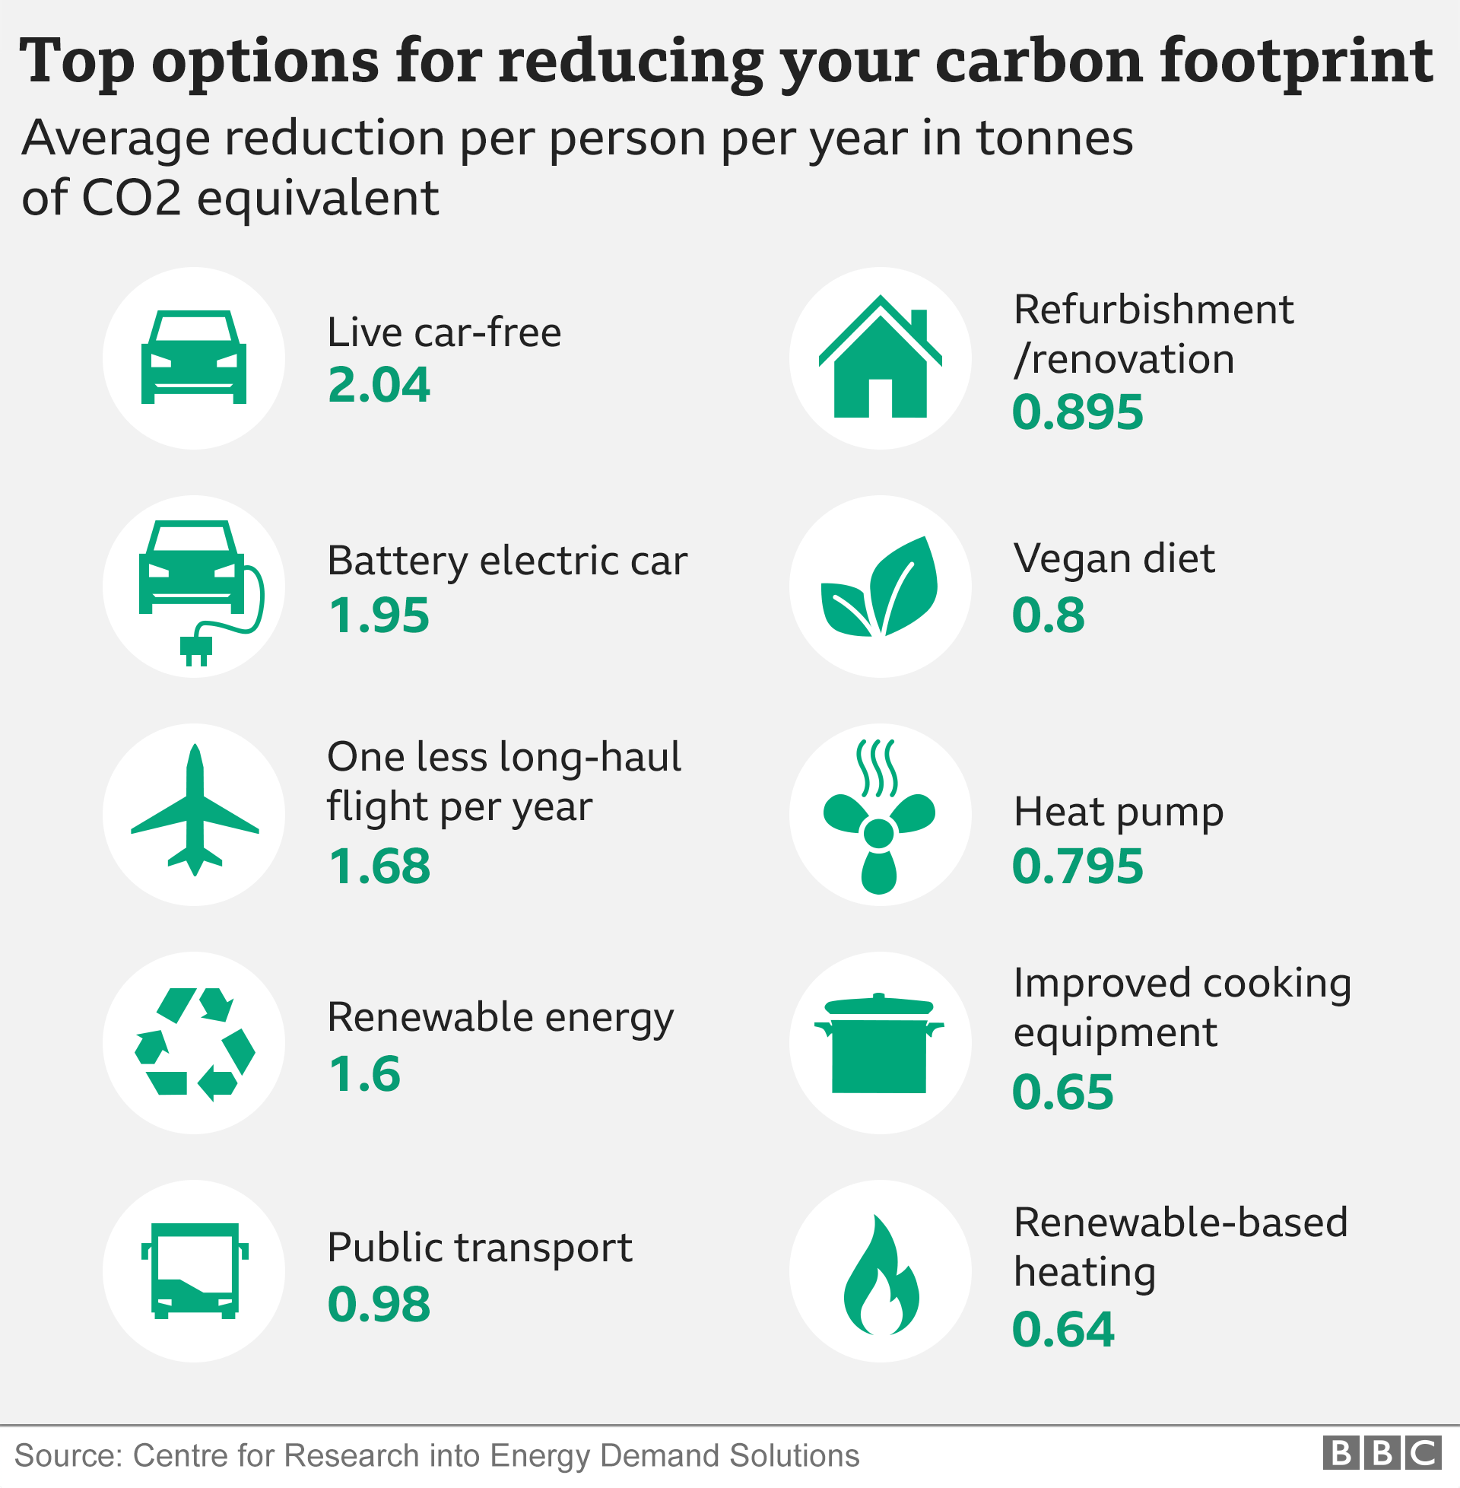
Reducing your carbon footprint
If you want to reduce your carbon footprint then there are many ways in which you can do so, these include;
Choosing a vegan diet
Improving the cooking equipment that you use
Using public transport when travelling
Stay car free
If you need a car, think about getting an electric car
The image show the tonnes that can be saved just by making some changes no matter how drastic or how small even the little changes can make a big difference.

Slide 6
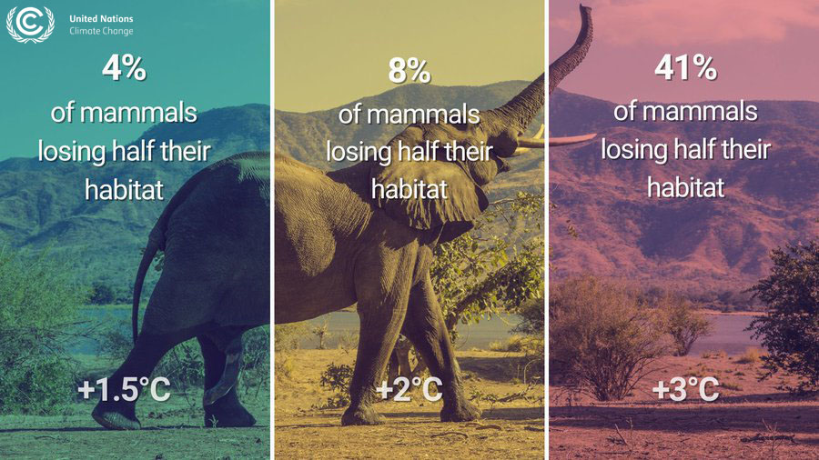
Animals
The world’s wildlife will face considerable maybe even catastrophic change if we do not change our ways, some ways in which animals are affected are;
Habitat loss; Rising temperatures affect vegetation, food sources, access to water and much more. Ecosystems may become uninhabitable for certain animals, forcing wildlife to migrate outside of their usual patterns in search of food and liveable conditions, while causing other animals to die off.
Human-wildlife conflict; Climate change intensifies human-wildlife conflict through habitat loss and extreme climate events, forcing people and wildlife to share increasingly crowded spaces. As ecosystems change, people and wildlife roam farther in search of food, water and resources.
These factors can lead to extinction: The combination of challenges could cause many animals to go extinct. The world’s most vulnerable animals, including those already near extinction, will likely face the biggest threats.

Slide 7
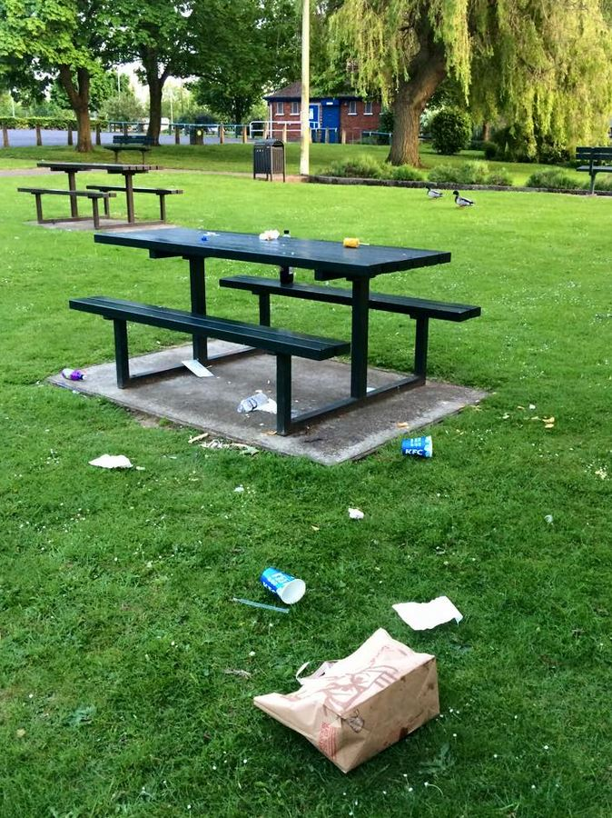
What is litter?
Litter can be many things, the most popular items being; Cigarette butts, Glass pieces and bottles and many varieties of plastic.
The primary causes of littering often come down to a disregard for the environment. Many people litter out of convenience, carelessly discarding bits of rubbish on the streets, from moving vehicles, or wherever it seems easiest.
This behaviour not only involves everyday items like plastic bottles and cigarette butts but also toxic substances that can severely harm marine life, disrupt the food chain, and degrade land and water quality.
The Worldwide Fund for Nature report that 1.5 million tonnes of plastic waste derives from water bottles.
33% of litter comes from fast food.
The UK has the worst statistics for litter, with a jaw-dropping 62% of England’s residents admitting to littering.

Slide 8
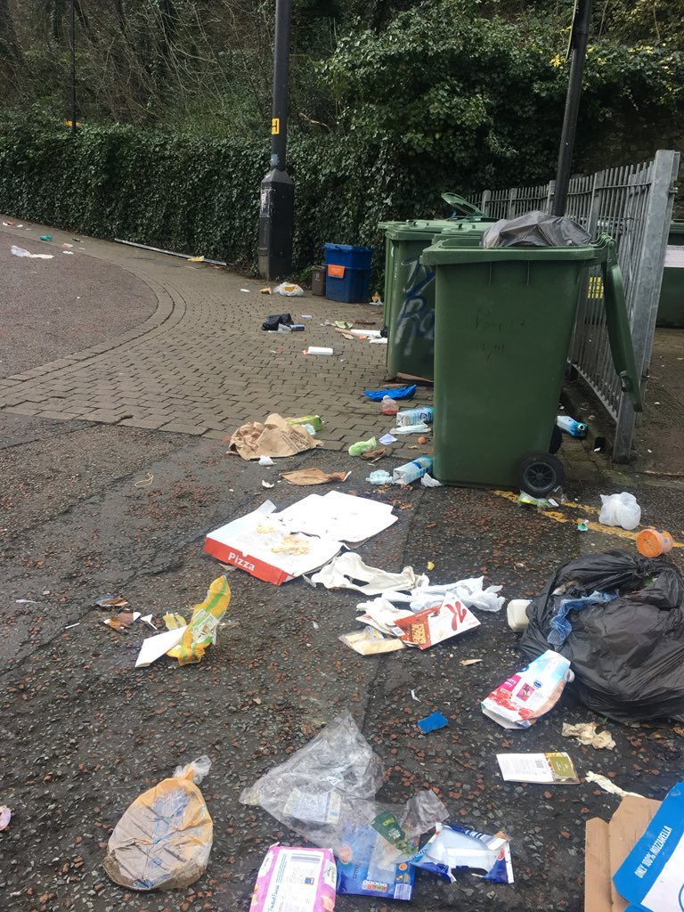
How does littering affect the environment?
Litter in public places, on the streets, and in tourist spots can devastatingly downgrade the appeal of such areas. This is worsened when people see these areas and feel it is ok to litter themselves.
Litter can severely degrade the quality of land, water, and air. They can end up in waterways such as the rivers, lakes, and oceans and pollute these bodies of water.
Litter is a potential breeding ground of germs and bacteria. When rodents and pests that are attracted to rubbish are in search of food, they can find their way into piles of litter and these creatures may harbour disease causing bacteria and infect people.

Slide 9
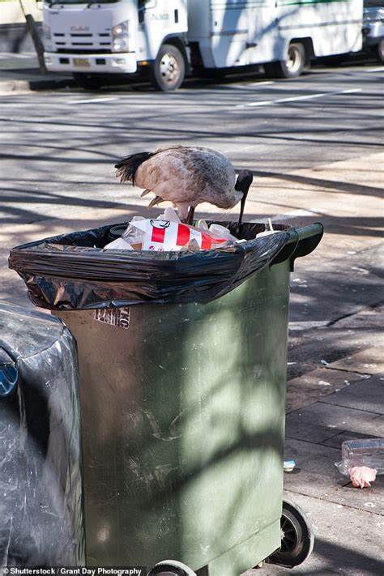
How does littering affect animals?
Sharp objects such as metal scraps and broken glass can also be injurious to marine wildlife, causing amputation of body parts as well as infections.
Litter can damage the habitats of marine and land animals such as the coral reefs. Pieces of junk may accumulate underwater and alter the natural habitat structure and safe living conditions of marine animals. Moreover, plastic debris can bring light and oxygen levels to toxic and unsustainable levels for these aquatic creatures.
Plastic litter is dangerous to animals because they can be mistaken as food by these critters. Furthermore, harmful chemicals can adhere to plastics and make them more toxic and hazardous when ingested by marine animals and birds.
As a result, their stomach capacity gets reduced since plastic cannot be digested. In the long run, this would affect their eating habits, eventually causing sickness and even death.
The RSPCA receives 5,000 calls a year regarding litter. That’s an average of roughly 14 calls every day!
One billion seabirds are killed by litter every year, while 260 marine animal species have become trapped by litter in the ocean.

Slide 10

Resources
For more information and help on how to get involved, please use the resources below.
Climate change: We need to take action urgently | Tes Magazine
BBC - Climate Change
BBC - Earth Day
The Little Book of Green Nudges | UNEP - UN Environment Programme

